Slide 1


Linux and Shell Scripting
Zero Lecture
Dr. Sheikh Umar Mushtaq
Assistant Professor

Slide 2
Introduction to CAP 269
Creating files
Disk Partitioning
Mounting
unmounting
Swap space

Slide 3
Creating Files
Touch filename.txt >>>>>>>>>> Create empty file
Cat > filename.txt >>>>>>>>>>> Type content of file and press ctrl+D to save and exit.
Cat filename.txt to display the contents of file.

Slide 4
Mounting a Disk/Partition
What is a mount point?
In Windows → every disk/partition gets a drive letter (C:, D:, E: etc).
In Linux → there are no drive letters. Instead, every storage device (disk, partition, USB) must be “attached” to the directory tree.
The place where it’s attached is called the mount point (just a normal folder).

Slide 5
🔹 Example
Suppose you plug in an extra hard disk (/dev/sdb1). Linux doesn’t know where in your filesystem you want to see its files.
So you create a folder:
mkdir /mnt/mydisk
Then mount it:
mount –t ext3 /dev/sdb1 /mnt/mydisk
mount /dev/sdb1 /mnt/mydisk
Now, when you go into /mnt/mydisk, you’ll see the contents of that disk.
A mount point is just a folder that acts like an entry door to access a disk/partition/USB inside your main Linux filesystem.

Slide 6
mkfs.vfat /dev/sdb2
This command is used to format the 2nd partition available in /dev/sdb2 to the VFAT file system. Even though we formatted the disks, it is of no use to us, unless we mount it on a directory.

Slide 7
Mounting a Disk/Partition
Create a mount point (folder where it will be attached)
mkdir /mnt/mydisk
Mount the partition to that folder
mount /dev/sdb1 /mnt/mydisk
Check if mounted:
df –h
Unmount (if needed):
umount /mnt/mydisk

Slide 8
Activity
Make one mount point
Make one directory in that mount point
Display using ls
Mount any partition on that mount point
Now make one directory in that mount point
Display using ls
Unmount and see the changes

Slide 9
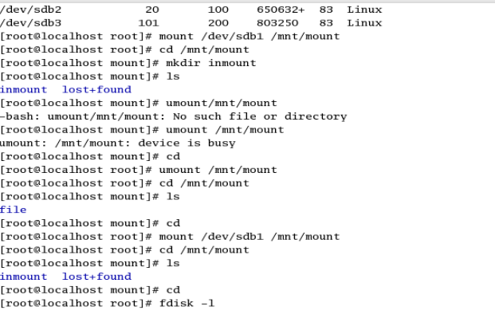


Slide 10
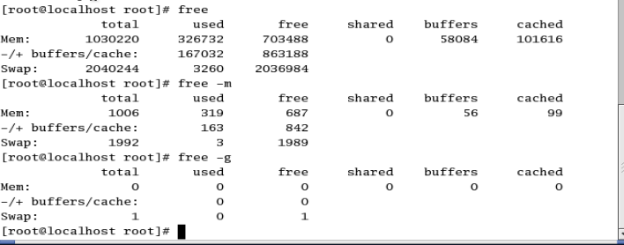
SwapSpace

Slide 11
Swapspace
Why do we use swap space?
Think of your RAM (memory) as a work desk.
If the desk is big enough, you can keep all your books and notes open at once.
If the desk is small (RAM is limited), you run out of space.
Swap space is like having an extra shelf nearby (on disk) where you can temporarily put things you don’t need right now.

Slide 12
Swapspace
Main reasons Linux uses swap
When RAM is full → system moves less-used data to swap, so applications don’t crash.
Run bigger programs than your physical RAM allows.
System hibernation → RAM contents are copied to swap before power off, so everything can be restored.

Slide 13
Swapspace
Example
Suppose you have 2 GB RAM.
You open many programs and they need 3 GB.
Without swap → your system will freeze or kill programs.
With 1 GB swap → Linux keeps most-used data in RAM and moves old/unused data into swap → system keeps running (just slower).

Slide 14
dd if=/dev/zero of=/swapfile bs=1M count=1024 # create 1GB file
chmod 600 /swapfile # secure permissions
mkswap /swapfile # make it swap
swapon /swapfile # enable it
Permission | Binary | Octal
rw- | 110 | 6
r-- | 100 | 4
--- | 000 | 0
chmod 600 file → rw-------
Owner: read + write = 6
Group: no permission = 0
Others: no permission = 0

Slide 15
Swap Space
Step 1: dd if=/dev/zero of=/swapfile bs=1M count=1024
What it does: Creates an empty file called /swapfile with size 1 GB (524,288 blocks × 1 KB each).
Output:
524288+0 records in
524288+0 records out
Means the file was created successfully

Slide 16
Step 2: chmod 600 /swapfile
What it does: Sets permissions so only root can read/write this file.
Why: For security (nobody else can read swap memory).
Step 3: mkswap /swapfile
What it does: Formats the file as swap space (like formatting a partition before use).
Output example:
Setting up swapspace version 1, size = 524284 KiB
Means the file is now ready to be used as swap.

Slide 17
Step 4: swapon /swapfile
What it does: Activates the swap file so the system can use it as extra virtual memory.
No big output, just works silently if successful.

Slide 18
Step 5: swapon -s OR free –m (may not give exact size because of other system partitions)
What it does: Shows current swap usage.
Expected output example:
Filename Type Size Used Priority
/swapfile file 1048568KB 0 -1
👉 In short: You created a 1GB file, locked its permissions, formatted it as swap, turned it on, and now your system has more "virtual RAM."
Turn off (if needed):
swapoff /swapfile

Slide 19
